Slide 1
18.404/6.840 Lecture 22
Last time: - Finished NL = coNL
- Time and Space Hierarchy Theorems
Today: (Sipser §9.2) - A “natural” intractable problem
- Oracles and P versus NP
1

Slide 2


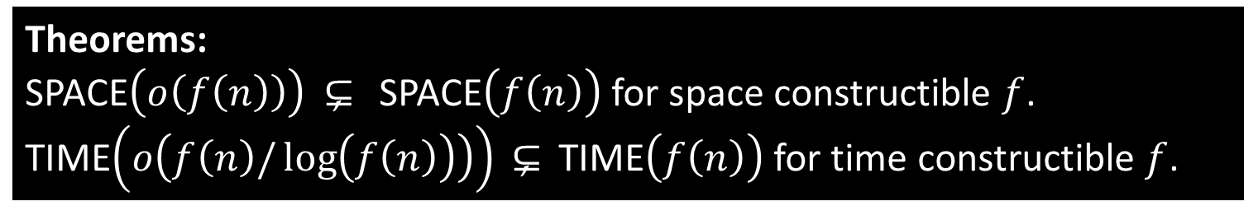









Review: Hierarchy Theorems
Theorems:
SPACE$\left(o\left(f\left(n\right)\right)\right) ⊆ \text{,}$ SPACE$\left(f\left(n\right)\right)$ for space constructible $f$.
TIME$\left(o\left(f\left(n\right)/\log\left(f\left(n\right)\right)\right)\right) ⊆ \text{,}$ TIME$\left(f\left(n\right)\right)$ for time constructible $f$.
SPACE $\left(2^{n}\right)$
. . .
TIME$\left(2^{n}\right)$
SPACE $\left(n^{4}\right)$
TIME$\left(n^{4}\right)$
. . .
SPACE $\left(n^{3}\right)$
TIME$\left(n^{3}\right)$
SPACE$\left(n^{2}\right)$
Check-in 22.1
Which of these are known to be true?
Check all that apply.
TIME$\left(2^{n}\right) ⊆ \text{,}$ TIME$\left(2^{n+1}\right)$
TIME$\left(2^{n}\right) ⊆ \text{,}$ TIME$\left(2^{2n}\right)$
NTIME$\left(n^{2}\right) ⊆ \text{,}$ PSPACE
NP $⊆ \text{,}$ PSPACE
TIME$\left(n^{2}\right)$
$$TQBF$$
Corollary: NL $⊆ \text{,}$ PSPACE
Implies $TQBF∉$ NL because the polynomial-time reductions in
the proof that $TQBF$ is PSPACE-complete can be done in log space.
PSPACE
NL
2
Check-in 22.1

Slide 3




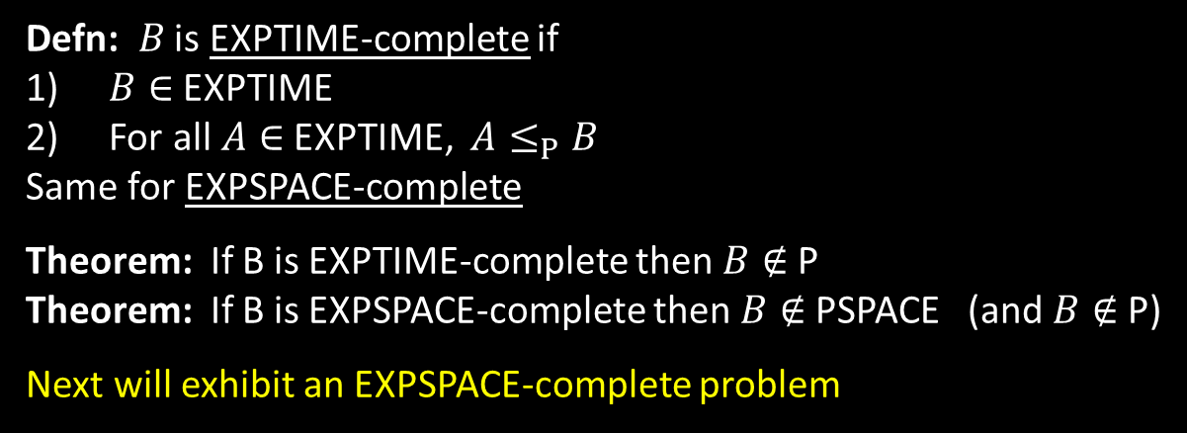
Exponential Complexity Classes
Defn: EXPTIME = $\bigcup_{k}{\text{TIME}\left(2^{\left(n^{k} \right)}\right)}$
EXPSPACE = $\bigcup_{k}{\text{SPAC}\text{E}\left(2^{\left(n^{k} \right)}\right)}$
Time Hierarchy Theorem
$$≠$$
L $⊆$ NL $⊆$ P $⊆$ NP $⊆$ PSPACE $⊆$ EXPTIME $⊆$ EXPSPACE
$$≠$$
$$≠$$
Space Hierarchy Theorem
Defn: $B$ is EXPTIME-complete if
$B∈$EXPTIME
For all $A∈$EXPTIME, $A≤_{P}B$
Same for EXPSPACE-complete
Theorem: If B is EXPTIME-complete then $B∉$P
Theorem: If B is EXPSPACE-complete then $B∉$PSPACE (and $B∉$P)
Next will exhibit an EXPSPACE-complete problem
intractable
3

Slide 4

A “Natural” Intractable Problem
Defn: $EQ\text{REX}$ $=\left\{〈R_{1},R_{2}〉\right| R_{1}$ and $R_{2}$ are equivalent regular expressions$\}$
Theorem: $EQ\text{REX}$ $∈$ PSPACE
Proof: Later (if time) or exercise (uses Savitch’s theorem).
Notation: If $R$ is a regular expression write $R^{k}$ to mean $\overset{k}{\overbrace{RR⋯R}}$ (exponent is written in binary).
Defn: ${EQ}_{REX↑}=\left\{〈R_{1},R_{2}〉\right| R_{1}$ and $R_{2}$ are equivalent regular expressions with exponentiation$\}$
Theorem: ${EQ}_{REX↑}$ is EXPSPACE-complete
Proof: 1) ${EQ}_{REX↑}∈$ EXPSPACE
2) If $A∈$ EXPSPACE then $A≤_{P}$ ${EQ}_{REX↑}$
1) Given regular expressions with exponentiation $R_{1}$ and $R_{2}$, expand the exponentiation by using repeated concatenation and then use $EQ\text{REX}$ $∈$ PSPACE.
The expansion is exponentially larger, so gives an EXPSPACE algorithm for ${EQ}_{REX↑}$.
2) Let $A∈$ EXPSPACE be decided by TM $M$ in space $2^{\left(n^{k}\right)}$.
Give a polynomial-time reduction $f$ mapping $A$ to ${EQ}_{REX↑}$.
4

Slide 5














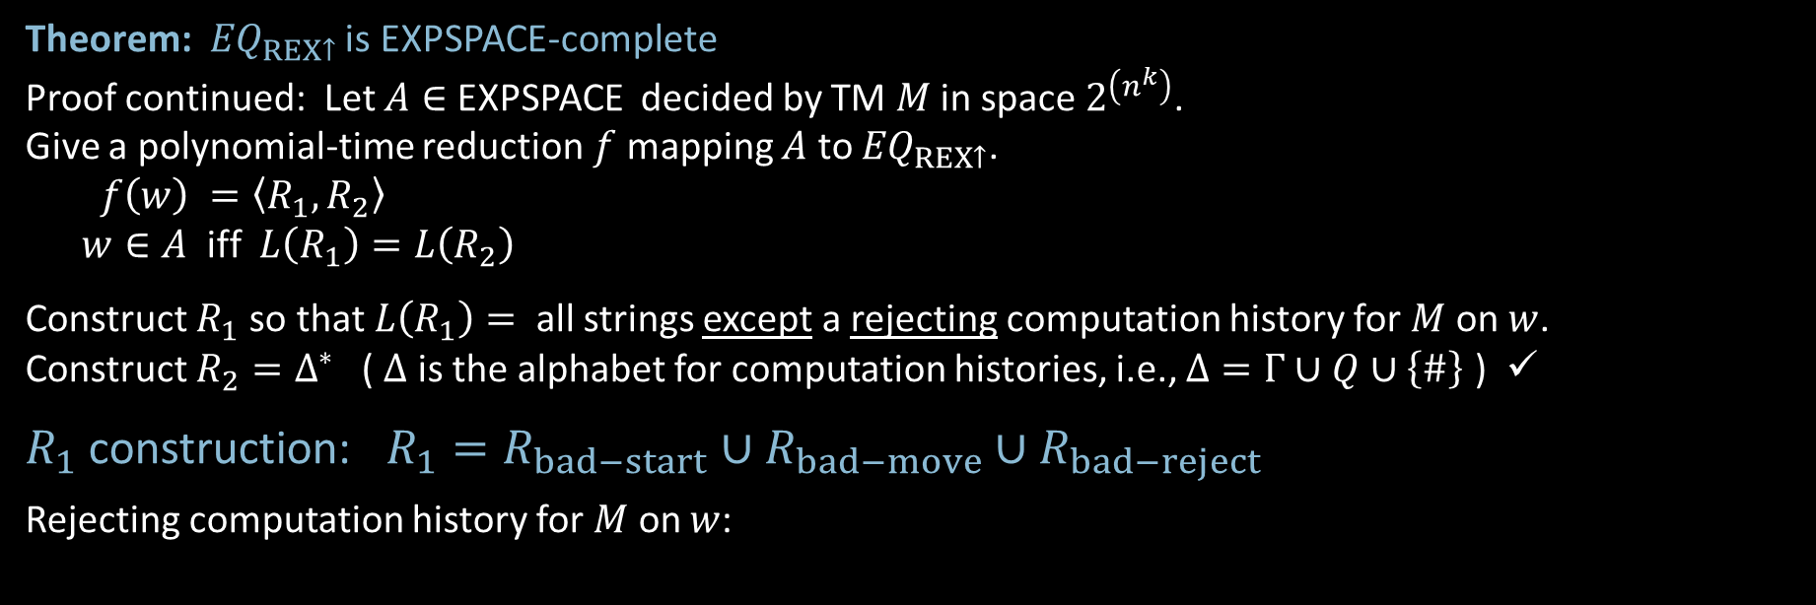


Showing $A$ $≤_{P}{EQ}_{REX↑}$
Theorem: ${EQ}_{REX↑}$ is EXPSPACE-complete
Proof continued: Let $A∈$ EXPSPACE decided by TM $M$ in space $2^{\left(n^{k}\right)}$.
Give a polynomial-time reduction $f$ mapping $A$ to ${EQ}_{REX↑}$.
$f\left(w\right) =〈R_{1},R_{2}〉$
$w∈A$ iff $L\left(R_{1}\right)=L\left(R_{2}\right)$
Construct $R_{1}$ so that $L\left(R_{1}\right)=$ all strings except a rejecting computation history for $M$ on $w$.
Construct $R_{2}=Δ^{∗}$ ( $Δ$ is the alphabet for computation histories, i.e., $Δ=Γ∪Q∪\left\{\#\right\}$ ) ✓
$R_{1}$ construction: $R_{1}=R_{bad−start}∪R_{bad−move}∪R_{bad−reject}$
Rejecting computation history for $M$ on $w$:
Check-in 22.2
Roughly estimate the size of the rejecting computation history for $M$ on $w$.
$2^{n}$ (c) $2^{2^{\left(n^{k}\right)}}$
$2^{\left(n^{k} \right)}$
$$2^{\left(n^{k} \right)}$$
$$2^{\left(n^{k} \right)}$$
$$2^{\left(n^{k} \right)}$$
Pad all configurations with blanks to have length $2^{\left(n^{k} \right)}$
$$q_{0}w_{1}w_{2}⋯w_{n}$$
˽ … ˽
$$\#$$
ababa $⋯$ abababa
$$\#$$
$$⋯$$
$$\#$$
$$⋯ q\text{reject} ⋯$$
$$C_{1}=C\text{star}\text{t}$$
$$C_{2}$$
$$C\text{reject}$$
5
Check-in 22.2

Slide 6


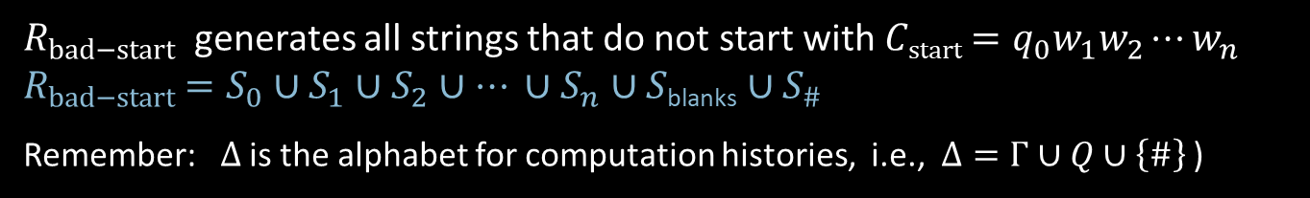













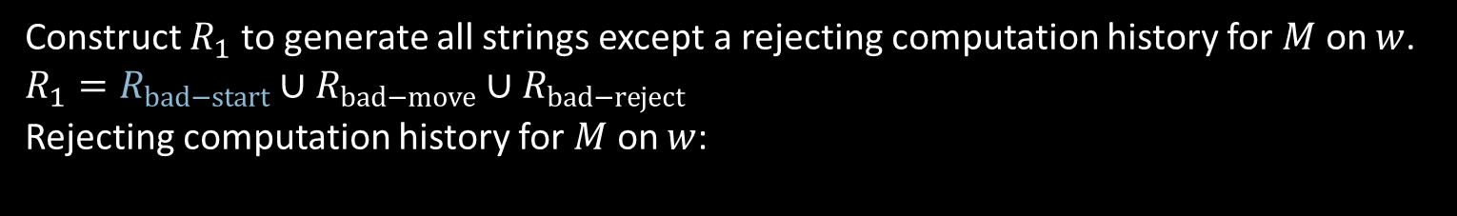



$A$ $≤_{P}{EQ}_{REX↑}$ ($R_{bad−start}$)
Construct $R_{1}$ to generate all strings except a rejecting computation history for $M$ on $w$.
$R_{1}=R_{bad−start}∪R_{bad−move}∪R_{bad−reject}$
Rejecting computation history for $M$ on $w$:
$$2^{\left(n^{k} \right)}$$
$$2^{\left(n^{k} \right)}$$
$$2^{\left(n^{k} \right)}$$
˽ … ˽
$$⋯$$
$$q_{0}w_{1}w_{2}⋯w_{n}$$
$$\#$$
ababa $⋯$ abababa
$$\#$$
$$\#$$
$$⋯ q\text{reject} ⋯$$
$$C_{1}=C\text{star}\text{t}$$
$$C_{2}$$
$$C\text{reject}$$
$S_{0}=Δ_{{−q}_{0}}Δ^{∗}$
$S_{1}=ΔΔ_{{−w}_{1}}Δ^{∗}$
$S_{2}=Δ^{2}Δ_{{−w}_{2}}Δ^{∗}$
$⋮$
$S_{n}=Δ^{n}Δ_{{−w}_{n}}Δ^{∗}$
$S_{n+1}=Δ^{n+1}Δ_{−X}Δ^{∗}$
$⋮$
$S_{2^{(n^{k})}−1}=Δ^{2^{(n^{k})}−1}Δ_{−X}Δ^{∗}$
$S_{\#}=Δ^{2^{(n^{k})}}Δ_{−\#}Δ^{∗}$
$R_{bad−start}$ generates all strings that do not start with $C\text{start}$ $=q_{0}w_{1}w_{2}⋯w_{n}$
$R_{bad−start}$ $=S_{0}∪S_{1}∪S_{2}∪⋯ ∪S_{n}∪S\text{blanks}$ $∪S_{\#}$
Remember: $Δ$ is the alphabet for computation histories, i.e., $Δ=Γ∪Q∪\left\{\#\right\}$ )
˽ … ˽
Notation: $Δ_{ε} =Δ∪\{ε\}$
$Δ_{−b}=Δ$ without b
$Δ_{}^{7}=$all strings of length 7
$Δ_{ε}^{7} =$all strings of length 0 thru 7
$$S\text{blanks}=Δ^{n+1}{Δ_{ε}}^{2^{\left(n^{k}\right)}−(n+2)}Δ_{−X}Δ^{∗}$$
˽
˽
all strings of length $n+1$ thru $2^{(n^{k})}−1$
˽
6

Slide 7


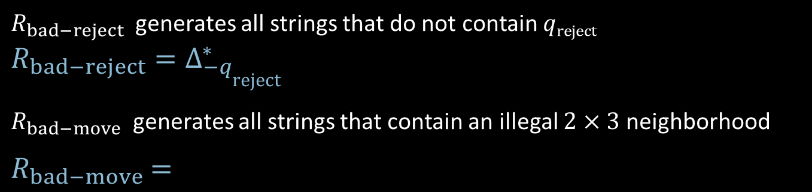



















$A$ $≤_{P}{EQ}_{REX↑}$ ($R_{bad−move} \& R_{bad−reject}$)
Construct $R_{1}$ to generate all strings except a rejecting computation history for $M$ on $w$.
$R_{1}=R_{bad−start}∪R_{bad−move}∪R_{bad−reject}$
Rejecting computation history for $M$ on $w$:
$$2^{\left(n^{k} \right)}$$
$$2^{\left(n^{k} \right)}$$
$$2^{\left(n^{k} \right)}$$
$$q_{0}w_{1}w_{2}⋯w_{n}$$
˽ … ˽
$$\#$$
ababa $⋯$ abababa
$$\#$$
$$⋯$$
$$\#$$
$$⋯ q\text{reject} ⋯$$
$$C_{1}=C\text{star}\text{t}$$
$$C_{2}$$
$$C\text{reject}$$
$R_{bad−reject}$ generates all strings that do not contain $q\text{reject}$
$R_{bad−reject}=Δ_{{−q}_{\text{reject}}}^{∗}$
$R_{bad−move}$ generates all strings that contain an illegal $2×3$ neighborhood
$R_{bad−move}$ $=$
illegal𝑐𝑎+𝑏Δ∗ abc Δ2𝑛𝑘−2 def Δ∗
$2^{\left(n^{k} \right)}$—$2$
$$⋯$$
abc
def
$$⋯$$
a | b | c
d | e | f
$$C_{i}$$
$$C_{i+1}$$
7

Slide 8

Computation with Oracles
Let $A$ be any language.
Defn: A TM $M$ with oracle for $A$, written $M^{A}$, is a TM equipped with a “black box” that can answer queries “is $x∈A$?” for free.
Example: A TM with an oracle for $SAT$ can decide all $B∈$ NP in polynomial time.
Defn: ${\text{P}}^{A}=\left\{B\right| B$ is decidable in polynomial time with an oracle for $A$}
Thus NP $⊆{\text{P}}^{SAT}$
NP $={\text{P}}^{SAT}$? Probably No because coNP $⊆{\text{P}}^{SAT}$
Defn: ${\text{NP}}^{A}=\left\{B\right| B$ is decidable in nondeterministic polynomial time with an oracle for $A$}
Recall MIN-FORMULA$=\left\{〈φ〉\right| φ$ is a minimal Boolean formula }
Example: $\overline{\text{MIN}\text{−}\text{FORMULA}}∈{\text{NP}}^{SAT}$
“On input $〈φ〉$
1. Guess shorter formula $ψ$
2. Use $SAT$ oracle to solve the coNP problem: $φ$ and $ψ$ are equivalent
3. Accept if $φ$ and $ψ$ are equivalent. Reject if not.”
8

Slide 9

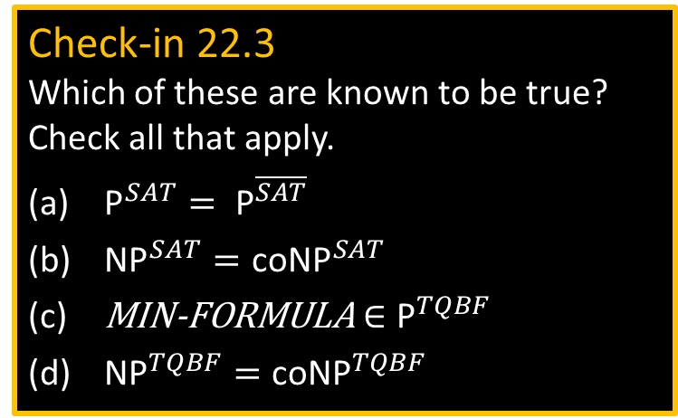
Oracles and P versus NP
Theorem: There is an oracle $A$ where ${\text{P}}^{A}={\text{NP}}^{A}$
Proof: Let $A=TQBF$
${\text{NP}}^{TQBF}⊆$ NPSPACE $=$ PSPACE $⊆$ ${\text{P}}^{TQBF}$
Relevance to the P versus NP question
Recall: We showed ${EQ}_{REX↑}∉$ PSPACE.
Could we show $SAT∉$ P using a similar method? NO.
Reason: Suppose YES.
The Hierarchy Theorems are proved by a diagonalization.
In this diagonalization, the TM $D$ simulates some TM $M$.
If both TMs were oracle TMs $D^{A}$ and $M^{A}$ with the same oracle $A$,
the simulation and the diagonalization would still work.
Therefore, if we could prove P $≠$ NP by a diagonalization,
we would also prove that ${\text{P}}^{A}≠{\text{NP}}^{A}$ for every oracle $A$.
But that is false!
Check-in 22.3
Which of these are known to be true?
Check all that apply.
${\text{P}}^{SAT}= {\text{P}}^{\overline{SAT}}$
${\text{NP}}^{SAT}{=\text{coNP}}^{SAT}$
MIN-FORMULA$∈{\text{P}}^{TQBF}$
${\text{NP}}^{TQBF}{=\text{coNP}}^{TQBF}$
9
Check-in 22.3

Slide 10

Quick review of today
Defined EXPTIME and EXPSPACE
Defined EXPTIME- and EXPSPACE-completeness
Showed ${EQ}_{REX↑}$ is EXPSPACE-complete and thus ${EQ}_{REX↑}∉$ PSPACE
Defined oracle TMs
Showed ${\text{P}}^{A}={\text{NP}}^{A}$ for some oracle $A$
Discussed relevance to the P vs NP question
10

Slide 11


$EQ\text{REX}$ $∈$ PSPACE
Theorem: $EQ\text{REX}$ $∈$ PSPACE
Proof: Show $\overline{EQ\text{RE}X}$ $∈$ NPSPACE
“On input $〈R_{1},R_{2}〉$ [ assume alphabet $Σ$ ]
1. Convert $R_{1}$ and $R_{2}$ to equivalent NFAs $N_{1}$ and $N_{2}$ having $m_{1}$ and $m_{2}$ states.
2. Nondeterministically guess the symbols of a string $s$ of length $2^{m_{1}+ m_{2}}$ and simulate $N_{1}$ and $N_{2}$ on $s$, storing only the current sets of states of $N_{1}$ and $N_{2}$.
3. If they ever disagree on acceptance then accept.
4. If always agree on acceptance then reject.”
11

Slide 12
MIT OpenCourseWare
https://ocw.mit.edu
18.404J Theory of Computation
Fall 2020
For information about citing these materials or our Terms of Use, visit: https://ocw.mit.edu/terms.

